Slide 1
INTRO to DATA SCIENCE recommendation Engines

Slide 2
I. Content-based filtering ii. Collaborative filtering exercise: III. Recommending with python iV. The netflix prize
agenda

Slide 3
Recommendation systems
A recommendation system aims to match users to products/items/brand/etc that they likely haven’t experienced yet.

Slide 4
Recommendation systems
A recommendation system aims to match users to products/items/brand/etc that they likely haven’t experienced yet.
This rating is produced by analyzing other user/item ratings (and sometimes item characteristics) to provide personalized recommendations to users.

Slide 5
Recommendation systems
There are two general approaches to the design:

Slide 6
Recommendation systems
There are two general approaches to the design:
In content-based filtering, items are mapped into a feature space, and recommendations depend on item characteristics.
In contrast, the only data under consideration in collaborative filtering are user-item ratings, and recommendations depend on user preferences.

Slide 7
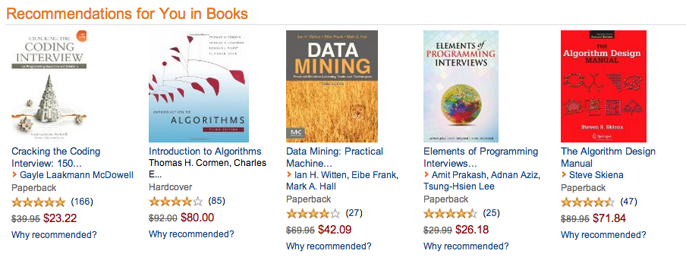
Examples – amazon Content-based
Notes:
Implicit feedback; eg browsing behavior (collaborative)

Slide 8
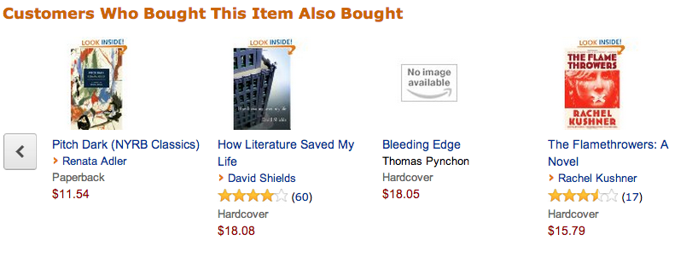
Examples – amazon collaborative filtering
Notes:
First & most famous example of item-based CF

Slide 9
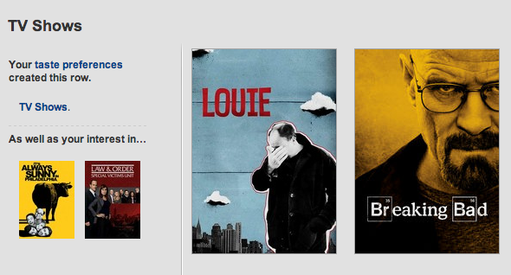
Examples – netflix
Notes:
collaborative

Slide 10
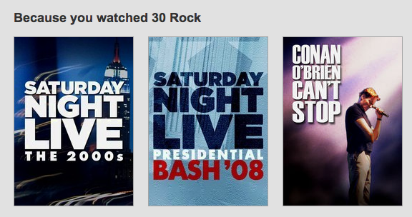
Examples – netflix
Notes:
Item-based

Slide 11
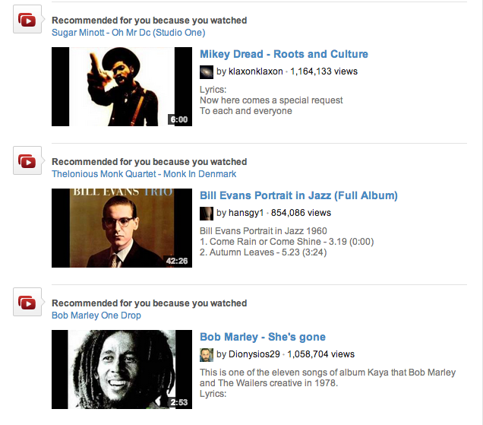
Examples – youtube
Notes:
item-based

Slide 12
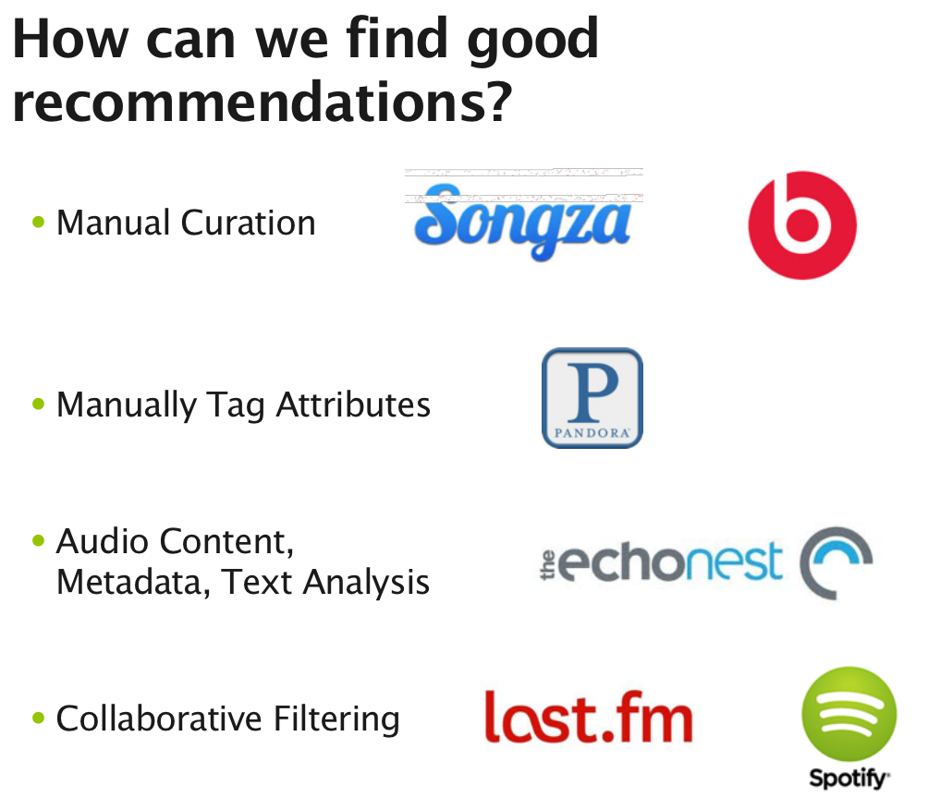
content-based
filtering
Notes:
Content-based

Slide 13
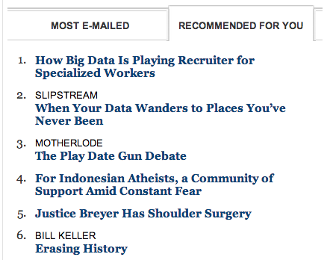
Examples – nytimes.com
Notes:
Content-based

Slide 14
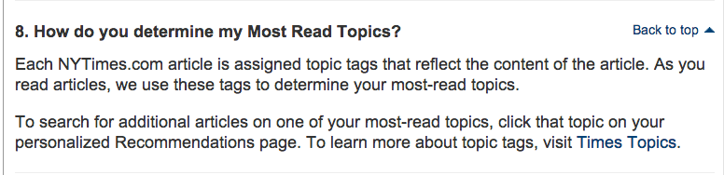

Examples – nytimes.com
NOTE
Collaborative or Content based?
Notes:
Content-based

Slide 15
Examples – nytimes.com
NOTE
Collaborative or Content based?
CONTENT BASED ☺
Notes:
Content-based

Slide 16
I. content-based filtering
INTRO TO DATA SCIENCE

Slide 17
Content-based filtering
Content-based filtering begins by mapping each item into a feature space. Both users and items are represented by vectors in this space.

Slide 18
Content-based filtering
Content-based filtering begins by mapping each item into a feature space. Both users and items are represented by vectors in this space.
Item vectors measure the degree to which the item is described by each feature, and user vectors measure a user’s preferences for each feature.

Slide 19
Content-based filtering
Content-based filtering begins by mapping each item into a feature space. Both users and items are represented by vectors in this space.
Item vectors measure the degree to which the item is described by each feature, and user vectors measure a user’s preferences for each feature.
Ratings are generated by taking dot products of user & item vectors.

Slide 20
Example – content-based filtering
features = (big box office, aimed at kids, famous actors)
Items (movies):
Finding Nemo = (5, 5, 2)
Mission Impossible = (3, -5, 5)
Jiro Dreams of Sushi = (-4, -5, -5)

Slide 21
Example – content-based filtering
features = (big box office, aimed at kids, famous actors)
Items (movies):
Finding Nemo = (5, 5, 2)
Mission Impossible = (3, -5, 5)
Jiro Dreams of Sushi = (-4, -5, -5)
Users:
Alice = (-3, 2, -2)
Bob = (4, -3, 5)

Slide 22
Example – content-based filtering
features = (big box office, aimed at kids, famous actors)
Items (movies): Prediction (for Alice)
Finding Nemo = (5, 5, 2) 5*-3 + 5*2 + 2*-2 = -9
Mission Impossible = (3, -5, 5)
Jiro Dreams of Sushi = (-4, -5, -5)
User:
Alice = (-3, 2, -2)

Slide 23
Example – content-based filtering
features = (big box office, aimed at kids, famous actors)
Items (movies): Prediction (for Alice)
Finding Nemo = (5, 5, 2) 5*-3 + 5*2 + 2*-2 = -9
Mission Impossible = (3, -5, 5) 3*-3 + -5*2 + 5*-2 = -29
Jiro Dreams of Sushi = (-4, -5, -5)
User:
Alice = (-3, 2, -2)

Slide 24
Example – content-based filtering
features = (big box office, aimed at kids, famous actors)
Items (movies): Prediction (for Alice)
Finding Nemo = (5, 5, 2) 5*-3 + 5*2 + 2*-2 = -9
Mission Impossible = (3, -5, 5) 3*-3 + -5*2 + 5*-2 = -29
Jiro Dreams of Sushi = (-4, -5, -5) -4*-3 + -5*2 + -5*-2 = +12
User:
Alice = (-3, 2, -2)

Slide 25

Example – content-based filtering
features = (big box office, aimed at kids, famous actors)
Items (movies): Prediction (for Alice)
Finding Nemo = (5, 5, 2) 5*-3 + 5*2 + 2*-2 = -9
Mission Impossible = (3, -5, 5) 3*-3 + -5*2 + 5*-2 = -29
Jiro Dreams of Sushi = (-4, -5, -5) -4*-3 + -5*2 + -5*-2 = +12
User:
Alice = (-3, 2, -2)

Slide 26
Example – content-based filtering
features = (big box office, aimed at kids, famous actors)
Items (movies): Prediction (for Bob)
Finding Nemo = (5, 5, 2)
Mission Impossible = (3, -5, 5)
Jiro Dreams of Sushi = (-4, -5, -5)
User:
Bob = (4, -3, 5)

Slide 27
Example – content-based filtering
features = (big box office, aimed at kids, famous actors)
Items (movies): Prediction (for Bob)
Finding Nemo = (5, 5, 2) 5*4 + 5*-3 + 2*5 = +15
Mission Impossible = (3, -5, 5) 3*4 + -5*-3 + 5*5 = +52
Jiro Dreams of Sushi = (-4, -5, -5) -4*4 + -5*-3 + -5*5 = -26
User:
Bob = (4, -3, 5)

Slide 28

Example – content-based filtering
features = (big box office, aimed at kids, famous actors)
Items (movies): Prediction (for Bob)
Finding Nemo = (5, 5, 2) 5*4 + 5*-3 + 2*5 = +15
Mission Impossible = (3, -5, 5) 3*4 + -5*-3 + 5*5 = +52
Jiro Dreams of Sushi = (-4, -5, -5) -4*4 + -5*-3 + -5*5 = -26
User:
Bob = (4, -3, 5)

Slide 29
content-based filtering
One notable example of content-based filtering is Pandora, which maps songs into a feature space using features (or “genes”) designed by the Music Genome Project.
Using song vectors that depend on these features, Pandora can create a station with music having similar properties to a song the user selects.

Slide 30
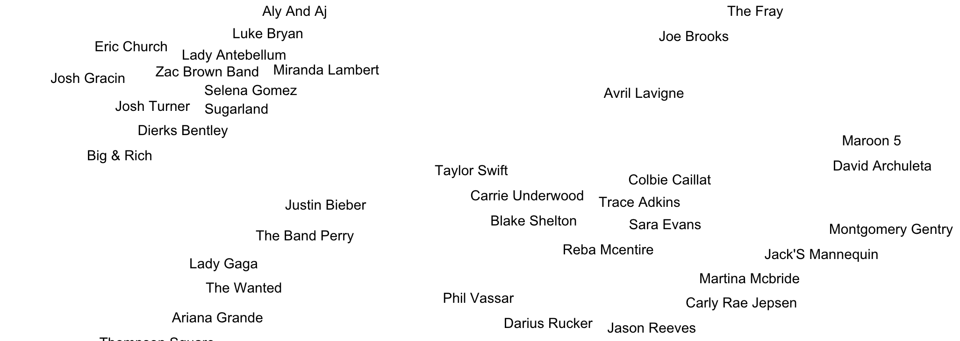
Visualization of similar artists
http://www.music-map.com/

Slide 31
content-based filtering
Content-based filtering has some difficulties:

Slide 32
content-based filtering
Content-based filtering has some difficulties:
Must map items into a feature space (usually by hand!)
Recommendations are limited in scope (items must be similar to each other)
Hard to create cross-content recommendations (eg books/music films…this would require comparing elements from different feature spaces!)

Slide 33
II. collaborative filtering
INTRO TO DATA SCIENCE

Slide 34
Collaborative filtering
Collaborative filtering refers to a family of methods for predicting ratings where instead of thinking about users and items in terms of a feature space, we are only interested in the existing user-item ratings themselves.

Slide 35
Collaborative filtering
Collaborative filtering refers to a family of methods for predicting ratings where instead of thinking about users and items in terms of a feature space, we are only interested in the existing user-item ratings themselves.
In this case, our dataset is a ratings matrix whose columns correspond to items, and whose rows correspond to users.

Slide 36
Collaborative filtering
Collaborative filtering refers to a family of methods for predicting ratings where instead of thinking about users and items in terms of a feature space, we are only interested in the existing user-item ratings themselves.
In this case, our dataset is a ratings matrix whose columns correspond to items, and whose rows correspond to users.
NOTE
The idea here is that users get value from recommendations based on other users with similar tastes.

Slide 37
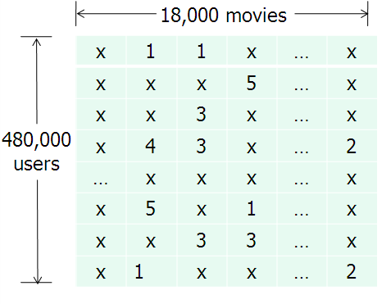
Ratings matrix
NOTE
This matrix will always be sparse!
source: http://www.eecs.berkeley.edu/~zhanghao/main/publications/subfolder/netflix.png

Slide 38
Collaborative filtering
Main difference between content and collaborative filtering:
Content Based:
maps items and users into a feature space
Collaborative:
relies on previous user-item ratings

Slide 39
Collaborative filtering
We will look at collaborative filtering in a user-user sense.

Slide 40
Collaborative filtering
We will look at collaborative filtering in a user-user sense.
We will take a given user, and find the K most similar users, and then recommend brands from the similar users!

Slide 41
Collaborative filtering
We will look at collaborative filtering in a user-user sense.
We will take a given user, and find the K most similar users, and then recommend brands from the similar users!
NOTE
Sound familiar? It’s similar to KNN!

Slide 42
Item-based collaborative filtering
Notes:
First & most famous example of item-based CF

Slide 43
Cold start problem
The system cannot draw inferences because it hasn’t gathered enough information yet.

Slide 44
Cold start problem
The cold start problem arises because we’ve been relying only on ratings data, or on explicit feedback from users.

Slide 45
Cold start problem
The cold start problem arises because we’ve been relying only on ratings data, or on explicit feedback from users.
Until users rate several items, we don’t know anything about their preferences!

Slide 46
Cold start problem
The cold start problem arises because we’ve been relying only on ratings data, or on explicit feedback from users.
Until users rate several items, we don’t know anything about their preferences!
We can get around this by enhancing our recommendations using implicit feedback, which may include things like item browsing behavior, search patterns, purchase history, etc.

Slide 47
Cold start problem
While explicit feedback (ratings, likes, purchases) leads to high quality ratings, the data is sparse and cold starts are problematic.

Slide 48
Cold start problem
While explicit feedback (ratings, likes, purchases) leads to high quality ratings, the data is sparse and cold starts are problematic.
Meanwhile implicit feedback (browsing behavior, etc.) leads to less accurate ratings, but the data is much more dense (and less invasive to collect).

Slide 49
III. Python example
INTRO TO DATA SCIENCE

Slide 50
Python exercise
Our data:
CSV of two columns, user ID and Brand
Each row represents a user liking a brand

Slide 51
Python exercise
Example:
User ID | Brand
86509 | H&M
86509 | Target
86509 | Old Navy
86510 | H&M
86510 | Lowe’s
86510 | Home Depot
86511 | Banana Republic
86511 | Kohl’s
86511 | Old Navy

Slide 52
Python exercise
How do we define “similarity” of users?

Slide 53
Python exercise
How do we define “similarity” of users?
This is required if we want to do user-based collaborative filtering

Slide 54

Python exercise
MATH ALERT!!

Slide 55
Python exercise
How do we define “similarity” of users?
Jaccard Similarity:
Defines similarity between two sets of objects

Slide 56
Python exercise
How do we define “similarity” of users?
Jaccard Similarity:
Defines similarity between two sets of objects

Slide 57
Python exercise
How do we define “similarity” of users?
Jaccard Similarity:
Defines similarity between two sets of objects
Number of similar elements
Number of distinct elements

Slide 58
Python exercise
JS ({1, 2, 3}, {2,3,4}) = {2, 3} 2
------ = ----
{1, 2, 3, 4} 4

Slide 59
Python exercise
Exercise:
User one: {“Target”, “Banana Republic”, “Old Navy”}
User two: {“Banana Republic”, “Gap”, “Kohl’s”}
JS (User one, User two) =

Slide 60
Python exercise
Exercise:
User one: {“Target”, “Banana Republic”, “Old Navy”}
User two: {“Banana Republic”, “Gap”, “Kohl’s”}
JS (User one, User two) = 1 / 5 = .2

Slide 61
Python algorithm steps
Get list of known users in a dictionary where the key is the user ID, an the value is a list of brands they like
Example: { ‘83065’ : ["Kohl's", 'Target’] }
For a given user, we will calculate their closeness to every user in csv
We will choose the K most similar users
Recommend brands liked by similar users

Slide 62
Python algorithm steps
Get list of known users in a dictionary where the key is the user ID, an the value is a list of brands they like
Example: { ‘83065’ : ["Kohl's", 'Target’] }
For a given user, we will calculate their closeness to every user in csv
We will choose the K most similar users
Recommend brands liked by similar users
Consider this a kind of KNN but instead of Euclidean Distance, we are using the Jaccard Similarity

Slide 63
IV. The netflix prize
INTRO TO DATA SCIENCE

Slide 64
The netflix prize
The Netflix prize was a competition to see if anyone could make a 10% improvement to Netflix’s recommendation system (accuracy measured by RMSE).

Slide 65
The netflix prize
The Netflix prize was a competition to see if anyone could make a 10% improvement to Netflix’s recommendation system (accuracy measured by RMSE).
The grand prize was $1m dollars

Slide 66
The netflix prize
The Netflix prize was a competition to see if anyone could make a 10% improvement to Netflix’s recommendation system (accuracy measured by RMSE).
The grand prize was $1m dollars
The ratings matrix contained >100mm numerical entries (1-5 stars) from ~500k users across ~17k movies. The data was split into train/quiz/test sets to prevent overfitting on the test data by answer submission (this was a clever idea!)

Slide 67
The netflix prize
The competition began in 2006, and the grand prize was eventually awarded in 2009. The winning entry was a stacked ensemble of 100’s of models (including neighborhood & matrix factorization models) that were blended using boosted decision trees.
Ultimately, the competition ended in a photo finish. The winning strategy came down to last-minute team mergers & creative blending schemes to shave 3rd & 4th decimals off RMSE (concerns that would not be important in practice).

Slide 68
The netflix prize
The competition began in 2006, and the grand prize was eventually awarded in 2009. The winning entry was a stacked ensemble of 100’s of models (including neighborhood & matrix factorization models) that were blended using boosted decision trees.
Ultimately, the competition ended in a photo finish. The winning strategy came down to last-minute team mergers & creative blending schemes to shave 3rd & 4th decimals off RMSE (concerns that would not be important in practice).
The competition did much to spur interest and research advances in recsys technology, and the prize money was donated to charity.
Notes:
http://www.techdirt.com/blog/innovation/articles/20120409/03412518422/why-netflix-never-implemented-algorithm-that-won-netflix-1-million-challenge.shtml

Slide 69
The netflix prize
Though they adopted some of the modeling techniques that emerged from the competition, Netflix never actually implemented the prizewinning solution.
Why do you think that’s true?
Notes:
http://techblog.netflix.com/2012/04/netflix-recommendations-beyond-5-stars.html

